Slide 1
Topic Number 2
Efficiency – Complexity -
Algorithm Analysis
"bit twiddling: 1. (pejorative) An exercise in tuning (see tune) in which incredible amounts of time and effort go to produce little noticeable improvement, often with the result that the code
becomes incomprehensible."
- The Hackers Dictionary, version 4.4.7

Slide 2
Clicker Question 1
“A program finds all the prime numbers between 2 and 1,000,000,000 from scratch
in 0.37 seconds."
  Is this a fast solution?
no
yes
it depends
CS 314
Efficiency - Complexity

Slide 3
Efficiency
Computer Scientists don’t just write programs.
They also analyze them.
How efficient is a program?
  How much time does it take program to complete?
  How much memory does a program use?
  How do these change as the amount
  of data changes?
  What is the difference between the average case and worst case efficiency if any?
CS 314
Efficiency - Complexity

Slide 4
Technique
Informal approach for this class
  more formal techniques in theory classes
How many computations will this program (method, algorithm) perform to get the answer?
Many simplifications
  view algorithms as Java programs
  determine by analysis the total number executable statements (computations) in program or method as a function of the amount of data
  focus on the dominant term in the function
  T(N) = 17.5N³ + 25N² + 35N + 251 IS ORDER N³

Slide 5
Counting Statements
int x; // one statement
x = 12; // one statement
int y = z * x + 3 % 5 * x / i; // 1
x++; // one statement
boolean p = x < y && y % 2 == 0 ||
z >= y * x; // 1
int[] data = new int[100]; // 100
data[50] = x * x + y * y; // 1
CS 314
Efficiency - Complexity

Slide 6
Clicker 2
What is output by the following code?
int total = 0;
for (int i = 0; i < 13; i++)
for (int j = 0; j < 11; j++)
total += 2;
System.out.println(total);
24
120
143
286
338
CS 314
Efficiency - Complexity

Slide 7
Clicker 3
What is output when method sample is called?
// pre: n >= 0, m >= 0
public static void sample(int n, int m) {
int total = 0;
for (int i = 0; i < n; i++)
for (int j = 0; j < m; j++)
total += 5;
System.out.println(total);
}
5 D. n^{m}
n * m E. (n * m)⁵
n * m * 5
CS 314
Efficiency - Complexity

Slide 8
Example
How many statements are executed by method total as a function of values.length
Let N = values.length
  N is commonly used as a variable that denotes the amount of data
public int total(int[] values) {
int result = 0;
for (int i = 0; i < values.length; i++)
result += values[i];
return result;
}
CS 314
Efficiency - Complexity

Slide 9
Counting Up Statements
int result = 0; 1
int i = 0; 1
i < values.length; N + 1
i++ N
result += values[i]; N
return total; 1
T(N) = 3N + 4
T(N) is the number of executable statements in method total as function of values.length
CS 314
Efficiency - Complexity

Slide 10
Another Simplification
When determining complexity of an algorithm we want to simplify things
  hide some details to make comparisons easier
Like assigning your grade for course
  At the end of CS314 your transcript won’t list all the details of your performance in the course
  it won’t list scores on all assignments, quizzes, and tests
  simply a letter grade, B- or A or D+
So we focus on the dominant term from the function and ignore the coefficient
CS 314
Efficiency - Complexity

Slide 11
Big O
The most common method and notation for discussing the execution time of algorithms is Big O, also spoken Order
Big O is the asymptotic execution time
of the algorithm
  In other words, how does the running time of the algorithm grow as a function of the amount of input data?
Big O is an upper bounds
It is a mathematical tool
Hide a lot of unimportant details by assigning a simple grade (function) to algorithms

Slide 12
Formal Definition of Big O
T(N) is O( F(N) ) if there are positive constants c and N₀ such that T(N) < cF(N) when N > N₀
  N is the size of the data set the algorithm works on
  T(N) is a function that characterizes the actual running time of the algorithm
  F(N) is a function that characterizes an upper bounds on T(N). It is a limit on the running time of the algorithm. (The typical Big functions table)
  c and N₀ are constants
CS 314
Efficiency - Complexity

Slide 13
What it Means
T(N) is the actual growth rate of the algorithm
  can be equated to the number of executable statements in a program or chunk of code
F(N) is the function that bounds the growth rate
  may be upper or lower bound
T(N) may not necessarily equal F(N)
  constants and lesser terms ignored because it is a bounding function
CS 314
Efficiency - Complexity

Slide 14
Showing O(N) is Correct
Recall the formal definition of Big O
  T(N) is O( F(N) ) if there are positive constants c and N₀ such that T(N) < cF(N) when N > N₀
Recall method total, T(N) = 3N + 4
  show method total is O(N).
  F(N) is N
We need to choose constants c and N₀
how about c = 4, N₀ = 5 ?
CS 314
Efficiency - Complexity

Slide 15
vertical axis: time for algorithm to complete. (simplified to
number of executable statements)
c * F(N), in this case,
c = 4, c * F(N) = 4N
T(N), actual function of number of computations.
In this case 3N + 4
F(N), approximate function
of computations. In this case N
N_{o} = 5
horizontal axis: N, number of elements in data set
CS 314
Efficiency - Complexity

Slide 16
Typical Big O Functions – "Grades"
Function | Common Name
N! | factorial
2^{N} | Exponential
N^{d}, d > 3 | Polynomial
N³ | Cubic
N² | Quadratic
N N | N Square root N
N log N | N log N
N | Linear
N | Root - n
log N | Logarithmic
1 | Constant
Running
time grows
'quickly' with
more input.
Running
time grows
'slowly' with
more input.
CS 314
Efficiency - Complexity

Slide 17
Clicker 4
Which of the following is true?
Recall T(N)_{total} = 3N + 4
Method total is O(N^{1/2})
Method total is O(N)
Method total is O(N²)
Two of A – C are correct
All of three of A – C are correct
CS 314
Efficiency - Complexity

Slide 18
Showing Order More Formally …
Show 10N² + 15N is O(N²)
Break into terms.
10N² < 10N²
15N < 15N² for N > 1 (Now add)
10N² + 15N < 10N² + 15N² for N > 1
10N² + 15N < 25N² for N > 1
c = 25, N₀ = 1
Note, the choices for c and N₀ are not unique.
CS 314
Efficiency - Complexity

Slide 19
Dealing with other methods
What do I do about method calls?
double sum = 0.0;
for (int i = 0; i < n; i++)
sum += Math.sqrt(i);
Long way
  go to that method or constructor and
  count statements
Short way
  substitute the simplified Big O function for
  that method.
  if Math.sqrt is constant time, O(1), simply count sum += Math.sqrt(i); as one statement.
CS 314
Efficiency - Complexity

Slide 20
Dealing With Other Methods
public int foo(int[] data) {
int total = 0;
for (int i = 0; i < data.length; i++)
total += countDups(data[i], data);
return total;
}
// method countDups is O(N) where N is the
// length of the array it is passed
Clicker 5, What is the Big O of foo?
O(1) B. O(N) C. O(NlogN)
D. O(N²) E. O(N!)
CS 314
Efficiency - Complexity

Slide 21
Independent Loops
// from the Matrix class
public void scale(int factor) {
for (int r = 0; r < numRows(); r++)
for (int c = 0; c < numCols(); c++)
iCells[r][c] *= factor;
}
numRows() returns number of rows in the matrix iCells
numCols() returns number of columns in the matrix iCells
Assume iCells is an N by N square matrix.
Assume numRows and numCols are O(1)
What is the T(N)? Clicker 6, What is the Order?
O(1) B. O(N) C. O(NlogN)
D. O(N²) E. O(N!)
Bonus question. What if numRows is O(N)?

Slide 22
Just Count Loops, Right?
// Assume mat is a 2d array of booleans.
// Assume mat is square with N rows,
// and N columns.
public static void count(boolean[][] mat,
int row, int col) {
int numThings = 0;
for (int r = row - 1; r <= row + 1; r++)
for (int c = col - 1; c <= col + 1; c++)
if (mat[r][c])
numThings++;
Clicker 7, What is the order of the method count?
O(1) B. O(N^{0.5}) C. O(N) D. O(N²) E. O(N³)
CS 314
Efficiency - Complexity

Slide 23
It is Not Just Counting Loops
// "Unroll" the loop of method count:
int numThings = 0;
if (mat[r-1][c-1]) numThings++;
if (mat[r-1][c]) numThings++;
if (mat[r-1][c+1]) numThings++;
if (mat[r][c-1]) numThings++;
if (mat[r][c]) numThings++;
if (mat[r][c+1]) numThings++;
if (mat[r+1][c-1]) numThings++;
if (mat[r+1][c]) numThings++;
if (mat[r+1][c+1]) numThings++;
CS 314
Efficiency - Complexity

Slide 24
Just Count Loops, Right?
private static void mystery(int[] data) {
stopIndex = data.length – 1;
int j = 1;
while (stopIndex > 0) {
if (data[j – 1] > data[j]) {
int t = data[j];
data[j] = data[j – 1];
data[j – 1] = t;
}
if (j == stopIndex) {
stopIndex--;
j = 1;
} else {
j++;
}
}
N = data.length
Clicker 8, What is the order of method mystery?
O(1) B. O(N^{0.5}) C. O(N) D. O(N²) E. O(N³)

Slide 25
Sidetrack, the logarithm
Thanks to Dr. Math
3² = 9
likewise log₃ 9 = 2
  "The log to the base 3 of 9 is 2."
The way to think about log is:
  "the log to the base x of y is the number you can raise x to to get y."
  Say to yourself "The log is the exponent." (and say it over and over until you believe it.)
  In CS we work with base 2 logs, a lot
log₂ 32 = ? log₂ 8 = ? log₂ 1024 = ? log₁₀ 1000 = ?
CS 314
Efficiency - Complexity

Slide 26
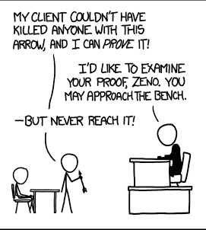
When Do Logarithms Occur
Algorithms tend to have a logarithmic term when they use a divide and conquer technique
the size of the data set keeps getting divided by 2
public int foo(int n) {
// pre n > 0
int total = 0;
while (n > 0) {
n = n / 2;
total++;
}
return total;
}
Clicker 9, What is the order of the above code?
O(1) B. O(logN) C. O(N)
D. O(Nlog N) E. O(N²)
The base of the log is typically not included as we can switch from one base to another by multiplying by a constant factor.

Slide 27
Significant Improvement – Algorithm with Smaller Big O function
Problem: Given an array of ints replace any element equal to 0 with the maximum positive value to the right of that element. (if no positive value to the right, leave unchanged.)
Given:
[0, 9, 0, 13, 0, 0, 7, 1, -1, 0, 1, 0]
Becomes:
[13, 9, 13, 13, 7, 7, 7, 1, -1, 1, 1, 0]
CS 314
Efficiency - Complexity

Slide 28
Replace Zeros – Typical Solution
public void replace0s(int[] data){
for(int i = 0; i < data.length; i++){
if (data[i] == 0) {
int max = 0;
for(int j = i+1; j<data.length; j++)
max = Math.max(max, data[j]);
data[i] = max;
}
}
}
Assume all values are zeros. (worst case)
Example of a dependent loops.
Clicker 10 - Number of times j < data.length evaluated?
O(1) B. O(N) C. O(NlogN)
D. O(N²) E. O(N!)

Slide 29
Replace Zeros – Alternate Solution
public void replace0s(int[] data){
int max =
Math.max(0, data[data.length – 1]);
int start = data.length – 2;
for (int i = start; i >= 0; i--) {
if (data[i] == 0)
data[i] = max;
else
max = Math.max(max, data[i]);
}
}
Clicker 11 - Big O of this approach?
O(1) B. O(N) C. O(NlogN)
D. O(N²) E. O(N!)
CS 314
Efficiency - Complexity

Slide 30
Clicker 12
Is O(N) really that much faster than O(N²)?
never
always
typically
Depends on the actual functions and the value of N.
1000N + 250 compared to N² + 10
When do we use mechanized computation?
N = 100,000
100,000,250 < 10,000,000,010 (10⁸ < 10¹⁰)

Slide 31
A VERY Useful Proportion
Since F(N) is characterizes the running time of an algorithm the following proportion should hold true:
F(N₀) / F(N₁) ~= time₀ / time₁
An algorithm that is O(N²) takes 3 seconds to run given 10,000 pieces of data.
  How long do you expect it to take when there are 30,000 pieces of data?
  common mistake
  logarithms?
CS 314
Efficiency - Complexity

Slide 32
Why Use Big O?
As we build data structures Big O is the tool we will use to decide under what conditions one data structure is better than another
Think about performance when there is a lot of data.
  "It worked so well with small data sets..."
  Joel Spolsky, Schlemiel the painter's Algorithm
Lots of trade offs
  some data structures good for certain types of problems, bad for other types
  often able to trade SPACE for TIME.
  Faster solution that uses more space
  Slower solution that uses less space
CS 314
Efficiency - Complexity

Slide 33
Big O Space
Big O could be used to specify how much space is needed for a particular algorithm
  in other words how many variables are needed
Often there is a time – space tradeoff
  can often take less time if willing to use more memory
  can often use less memory if willing to take longer
  truly beautiful solutions take less time and space
The biggest difference between time and space is that you can't reuse time. - Merrick Furst
CS 314
Efficiency - Complexity

Slide 34
Quantifiers on Big O
It is often useful to discuss different cases for an algorithm
Best Case: what is the best we can hope for?
  least interesting, but a good exercise
  Don't assume no data. Amount of date is still variable, possibly quite large
Average Case (a.k.a. expected running time): what usually happens with the algorithm?
Worst Case: what is the worst we can expect of the algorithm?
  very interesting to compare this to the average case
CS 314
Efficiency - Complexity

Slide 35
Best, Average, Worst Case
To Determine the best, average, and worst case Big O we must make assumptions about the data set
Best case -> what are the properties of the data set that will lead to the fewest number of executable statements (steps in the algorithm)
Worst case -> what are the properties of the data set that will lead to the largest number of executable statements
Average case -> Usually this means assuming the data is randomly distributed
  or if I ran the algorithm a large number of times with different sets of data what would the average amount of work be for those runs?
CS 314
Efficiency - Complexity

Slide 36
Another Example
public double minimum(double[] values) {
int n = values.length;
double minValue = values[0];
for (int i = 1; i < n; i++)
if (values[i] < minValue)
minValue = values[i];
return minValue;
}
T(N)? F(N)? Big O? Best case? Worst Case? Average Case?
If no other information, assume asking average case
CS 314
Efficiency - Complexity

Slide 37
Example of Dominance
Look at an extreme example. Assume the actual number as a function of the amount of data is:
N²/10000 + 2Nlog₁₀ N+ 100000
Is it plausible to say the N² term dominates even though it is divided by 10000 and that the algorithm is O(N²)?
What if we separate the equation into (N²/10000) and (2N log₁₀ N + 100000) and graph the results.
CS 314
Efficiency - Complexity

Slide 38
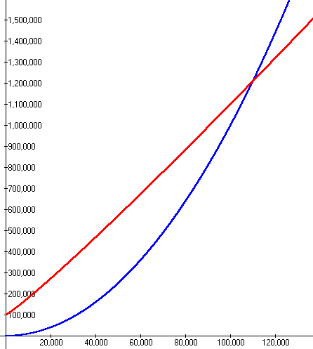
Summing Execution Times
For large values of N the N² term dominates so the algorithm is O(N²)
When does it make sense to use a computer?
red line is
2Nlog10 N + 100000
blue line is
N²/10000
CS 314
Efficiency - Complexity

Slide 39
Comparing Grades
Assume we have a problem
Algorithm A solves the problem correctly and is O(N²)
Algorithm B solves the same problem correctly and is O(N log₂N )
Which algorithm is faster?
One of the assumptions of Big O is that the data set is large.
The "grades" should be accurate tools if this holds true.
CS 314
Efficiency - Complexity

Slide 40
Running Times
Assume N = 100,000 and processor speed is 1,000,000,000 operations per second
Function | Running Time
2^{N} | 3.2 x 10^{30,086} years
N⁴ | 3171 years
N³ | 11.6 days
N² | 10 seconds
N N | 0.032 seconds
N log N | 0.0017 seconds
N | 0.0001 seconds
N | 3.2 x 10⁻⁷ seconds
log N | 1.2 x 10⁻⁸ seconds
CS 314
Efficiency - Complexity

Slide 41
Theory to Practice OR
Dykstra says: "Pictures are for the Weak."
 | 1000 | 2000 | 4000 | 8000 | 16000 | 32000 | 64000 | 128K
O(N) | 2.2x10⁻⁵ | 2.7x10⁻⁵ | 5.4x10⁻⁵ | 4.2x10⁻⁵ | 6.8x10⁻⁵ | 1.2x10⁻⁴ | 2.3x10⁻⁴ | 5.1x10⁻⁴
O(NlogN) | 8.5x10⁻⁵ | 1.9x10⁻⁴ | 3.7x10⁻⁴ | 4.7x10⁻⁴ | 1.0x10⁻³ | 2.1x10⁻³ | 4.6x10⁻³ | 1.2x10⁻²
O(N^{3/2}) | 3.5x10⁻⁵ | 6.9x10⁻⁴ | 1.7x10⁻³ | 5.0x10⁻³ | 1.4x10⁻² | 3.8x10⁻² | 0.11 | 0.30
O(N²) ind. | 3.4x10⁻³ | 1.4x10⁻³ | 4.4x10⁻³ | 0.22 | 0.86 | 3.45 | 13.79 | ⁽⁵⁵⁾
O(N²) dep. | 1.8x10⁻³ | 7.1x10⁻³ | 2.7x10⁻² | 0.11 | 0.43 | 1.73 | 6.90 | ^{(27.6)}
O(N³) | 3.40 | 27.26 | ⁽²¹⁸⁾ | ⁽¹⁷⁴⁵⁾ ^{29 min.} | ^{(13,957)} ^{233 min} | ^{(112k)} ^{31 hrs} | ^{(896k)} ^{10 days} | ^{(7.2m)} ^{80 days}
Times in Seconds. Red indicates predicated value.
CS 314
Efficiency - Complexity

Slide 42
Change between Data Points
 | 1000 | 2000 | 4000 | 8000 | 16000 | 32000 | 64000 | 128K | 256k | 512k
O(N) | - | ^{1.21} | ^{2.02} | ^{0.78} | ^{1.62} | ^{1.76} | ^{1.89} | ^{2.24} | ^{2.11} | ^{1.62}
O(NlogN) | ⁻ | ^{2.18} | ^{1.99} | ^{1.27} | ^{2.13} | ^{2.15} | ^{2.15} | ^{2.71} | ^{1.64} | ^{2.40}
O(N^{3/2}) | ⁻ | ^{1.98} | ^{2.48} | ^{2.87} | ^{2.79} | ^{2.76} | ^{2.85} | ^{2.79} | ^{2.82} | ^{2.81}
O(N²) ind | ⁻ | ^{4.06} | ^{3.98} | ^{3.94} | ^{3.99} | ^{4.00} | ^{3.99} | ⁻ | ⁻ | ⁻
O(N²) dep | ⁻ | ^{4.00} | ^{3.82} | ^{3.97} | ^{4.00} | ^{4.01} | ^{3.98} | ⁻ | ⁻ | ⁻
O(N³) | ⁻ | ^{8.03} | ⁻ | ⁻ | ⁻ | ⁻ | ⁻ | ⁻ | ⁻ | ⁻
Value obtained by Time_{x} / Time_{x-1}
CS 314
Efficiency - Complexity

Slide 43
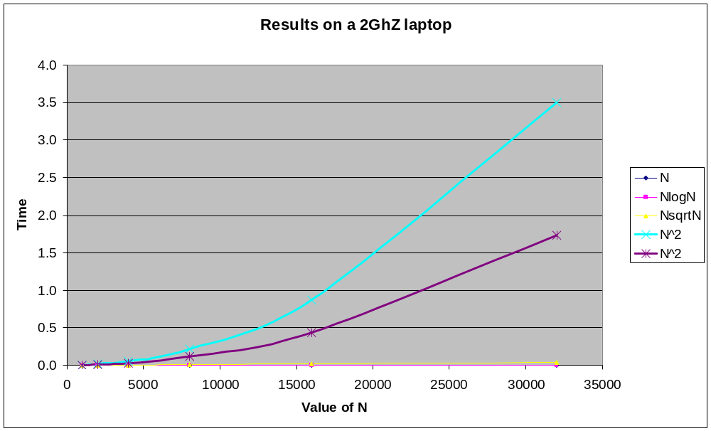
Okay, Pictures
CS 314
Efficiency - Complexity

Slide 44
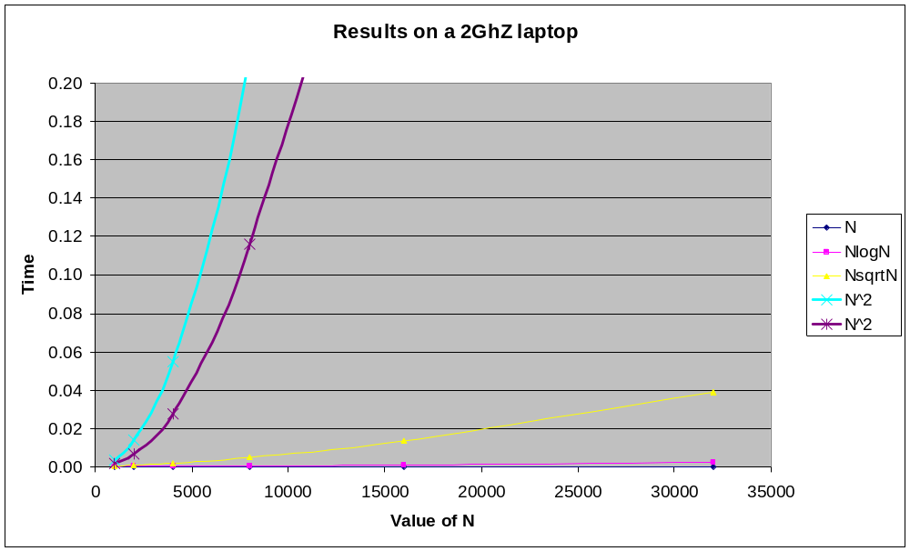
Put a Cap on Time
CS 314
Efficiency - Complexity

Slide 45
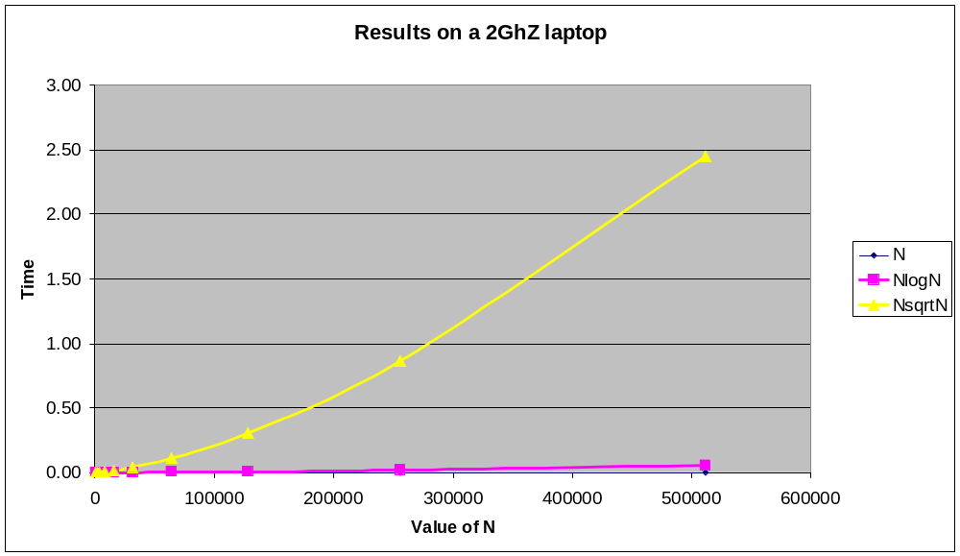
No O(N^2) Data
CS 314
Efficiency - Complexity

Slide 46
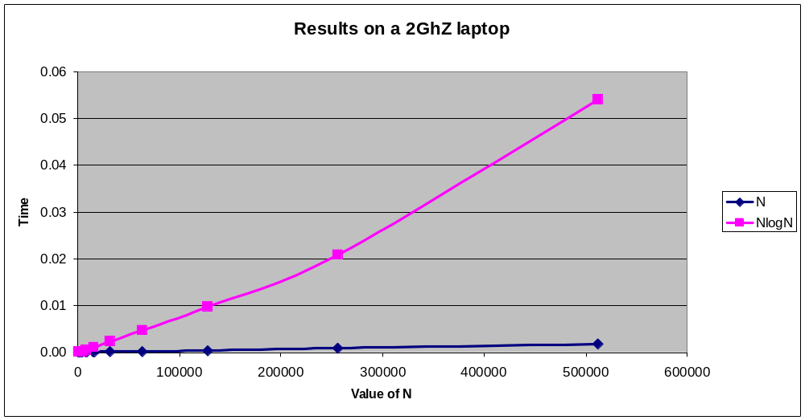
Just O(N) and O(NlogN)
CS 314
Efficiency - Complexity

Slide 47
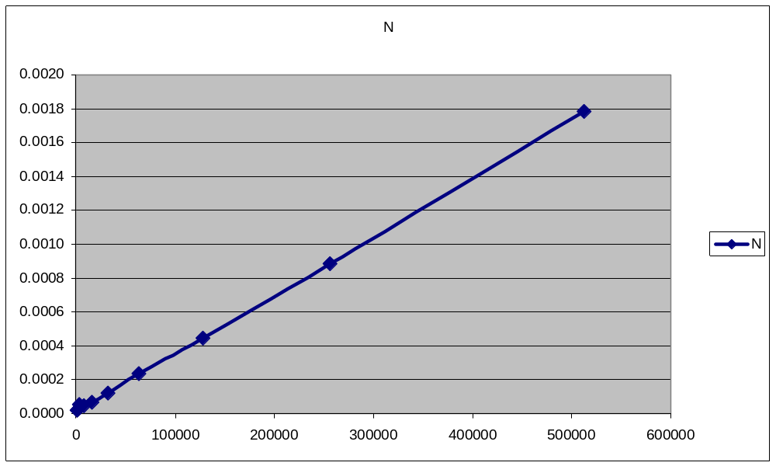
Just O(N)
CS 314
Efficiency - Complexity

Slide 48
10⁹ instructions/sec, runtimes
N | O(log N) | O(N) | O(N log N) | O(N²)
10 | 0.000000003 | 0.00000001 | 0.000000033 | 0.0000001
100 | 0.000000007 | 0.00000010 | 0.000000664 | 0.0001000
1,000 | 0.000000010 | 0.00000100 | 0.000010000 | 0.001
10,000 | 0.000000013 | 0.00001000 | 0.000132900 | 0.1 min
100,000 | 0.000000017 | 0.00010000 | 0.001661000 | 10 seconds
1,000,000 | 0.000000020 | 0.001 | 0.0199 | 16.7 minutes
1,000,000,000 | 0.000000030 | 1.0 second | 30 seconds | 31.7 years
CS 314
Efficiency - Complexity

Slide 49
Formal Definition of Big O (repeated)
T(N) is O( F(N) ) if there are positive constants c and N₀ such that T(N) < cF(N) when N > N₀
  N is the size of the data set the algorithm works on
  T(N) is a function that characterizes the actual running time of the algorithm
  F(N) is a function that characterizes an upper bounds on T(N). It is a limit on the running time of the algorithm
  c and N₀ are constants
CS 314
Efficiency - Complexity

Slide 50
More on the Formal Definition
There is a point N₀ such that for all values of N that are past this point, T(N) is bounded by some multiple of F(N)
Thus if T(N) of the algorithm is O( N^2 ) then, ignoring constants, at some point we can bound the running time by a quadratic function.
given a linear algorithm it is technically correct to say the running time is O(N ^ 2). O(N) is a more precise answer as to the Big O of the linear algorithm
  thus the caveat “pick the most restrictive function” in Big O type questions.
CS 314
Efficiency - Complexity

Slide 51
What it All Means
T(N) is the actual growth rate of the algorithm
  can be equated to the number of executable statements in a program or chunk of code
F(N) is the function that bounds the growth rate
  may be upper or lower bound
T(N) may not necessarily equal F(N)
  constants and lesser terms ignored because it is a bounding function
CS 314
Efficiency - Complexity

Slide 52
Other Algorithmic Analysis Tools
Big Omega T(N) is Ω( F(N) ) if there are positive constants c and N₀ such that
T(N) > cF( N )) when N > N₀
  Big O is similar to less than or equal, an upper bounds
  Big Omega is similar to greater than or equal, a lower bound
Big Theta T(N) is θ( F(N) ) if and only if T(N) is O( F(N) )and T( N ) is Ω( F(N) ).
  Big Theta is similar to equals
CS 314
Efficiency - Complexity

Slide 53
Relative Rates of Growth
Analysis Type | Mathematical Expression | Relative Rates of Growth
Big O | T(N) = O( F(N) ) | T(N) < F(N)
Big Ω | T(N) = Ω( F(N) ) | T(N) > F(N)
Big θ | T(N) = θ( F(N) ) | T(N) = F(N)
"In spite of the additional precision offered by Big Theta,
Big O is more commonly used, except by researchers
in the algorithms analysis field" - Mark Weiss
CS 314
Efficiency - Complexity

